Slide 1
CS 3006 Parallel and Distributed Computing Lecture 5
Danyal Farhat
FAST School of Computing
NUCES Lahore

Slide 2
Principles of Parallel Algorithm Design, Task Dependency Graphs, Granularity and Concurrency, Task Interaction Graphs

Slide 3
Outline
Steps in Parallel Algorithm Design
Parallel Computing Example
Task Decomposition
Multiplication of a Dense Matrix with a Vector
Vector Multiplication n x 1
Matrix Multiplication n x n
Task Dependency Graph
Example of Task Dependence
Granularity

Slide 4
Outline (Cont.)
Maximum and Average Degree of Concurrency
Critical Path and Critical Path Length
Exercise – Task Dependence Graph
Task Interaction Graph
Processes and Mapping
Processes vs Processors
Summary
Additional Resources

Slide 5
Steps in Parallel Algorithm Design
Identification: Identifying portions of the work that can be performed concurrently.
Work-units are also known as tasks
E.g., Initializing two mega-arrays are two tasks and can be performed in parallel
Mapping: The process of mapping concurrent pieces of the work or tasks onto multiple processes running in parallel.
Goal: balance load; maximize data locality
Approach: static vs. dynamic task assignment
Process is logical agent for computation over a physical processing element (processor).

Slide 6
Steps in Parallel Algorithm Design (Cont.)
Data Partitioning: Distributing the input, output, and intermediate data associated with the program.
One way is to copy whole data at each processing node
Memory challenges for huge-size problems
Other way is to give fragments of data to each processing node
Communication overheads
Defining Access Protocol: Managing accesses to data shared by multiple processors
Access protocol that manage communication and synchronization

Slide 7
Parallel Computing Example
Chess Player
A parallel program to play chess might look at all the possible first moves it could make
Each different first move could be explored by a different processor, to see how the game would continue from that point
Results have to be combined to figure out which is the best first move
Famous IBM Deep Blue machine that beat Kasparov
Brute force computing power
Massively parallel with 30 nodes, with each node containing a 120 MHz P2SC microprocessor

Slide 8
Load Balance
Inefficient if many processors are idle while one processor has lots of work to do and slowdown the whole application
Best utilizations of parallel processors
Parallel processors are typically symmetric
For example
Web Servers
Matrix Multiplication

Slide 9
Task Decomposition
Decomposition
“The process of dividing a computation into smaller parts, some or all of which may potentially be executed in parallel.”
Tasks
Programmer-defined units of computation into which the main computation is subdivided by means of decomposition
Tasks can be of arbitrary size, but once defined, they are regarded as indivisible units of computation
Simultaneous execution of multiple tasks is the key to reducing the time required to solve the entire problem

Slide 10
Multiplication of a Dense Matrix with a Vector
Problem can be decomposed into n tasks
Computation of each element of vector y is independent of other elements
No control dependencies so no task-dependency graph

Slide 11
Vector Multiplication n x 1
So the sequential multiplication program like:
for (row = 0; row < n; row++)
y[row] = dot_product( get_row(A, row), get_col(b));
Can be transformed to parallel program:
for (row = 0; row < n; row++)
y[row]= create_thread ( dot_product(get_row(A, row), get_col(b)));

Slide 12
Matrix Multiplication n x n
Sequential:
for (row = 0; row < n; row++)
for (column = 0; column < n; column++)
c[row][column] = dot_product( get_row(a, row), get_col(b, col));
Multithreaded:
for (row = 0; row < n; row++)
for (column = 0; column < n; column++)
c[row][column] = create_thread( dot_product(get_row(a, row), get_col(b, col)));

Slide 13
Task Dependency Graph
The tasks in the previous examples are independent and can be performed in any sequence.
In most of the problems, there exist some sort of dependencies between the tasks.
An abstraction used to express such dependencies among tasks and their relative order of execution is known as a task-dependency graph.

Slide 14
Task Dependency Graph (Cont.)
“It is a directed acyclic graph in which node are tasks and the directed edges indicate the dependencies between them”
The task corresponding to a node can be executed when all tasks connected to this node by incoming edges have completed
Some tasks may use data produced by other tasks and thus may need to wait for these tasks to finish execution

Slide 15
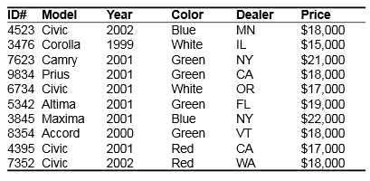
Example of Task Dependence
Execution of the query:
MODEL = “CIVIC” AND YEAR = 2001 AND
(COLOR = “GREEN” OR COLOR = “WHITE”)

Slide 16
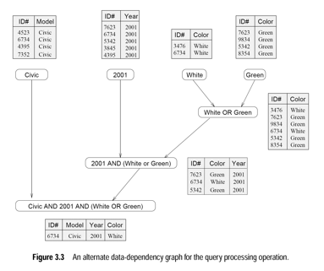
Task Dependency Graph (Cont.)

Slide 17
Granularity
The number and sizes of tasks into which a problem is decomposed determines the granularity of the decomposition
Granularity: roughness (means consisting of small grains or particles)
A decomposition into a large number of small tasks is called fine-grained
A decomposition into a small number of large tasks is called coarse-grained
For matrix-vector multiplication, the decomposition would usually be considered fine-grained, although coarse-grained could also be an option

Slide 18
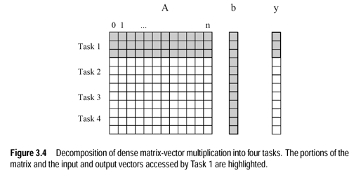
Granularity (Cont.)
Below figure shows a coarse-grained decomposition as each tasks computes n/3 of the entries of the output vector of length n

Slide 19
Maximum Degree of Concurrency
“The maximum number of tasks that can be executed simultaneously in a parallel program at any given time is known as its maximum degree of concurrency.”
Usually, it is always less than total number of tasks due to dependencies.
E.g., max-degree of concurrency in the task-graphs of Figure 3.3 is 4.
Rule of thumb: For task-dependency graphs that are trees, the maximum degree of concurrency is always equal to the number of leaves in the tree

Slide 20
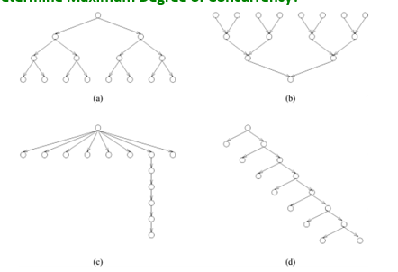
Maximum Degree of Concurrency (Cont.)
Determine Maximum Degree of Concurrency?
Notes:
In above examples, the maximum degree of concurrency = Leaf Nodes = 8

Slide 21
Average Degree of Concurrency
Relatively better measure for performance of parallel program
“The average number of tasks that can run concurrently over the entire duration of execution of the program”
The ratio of the total amount of work to the critical-path length
So, what is the critical path in a graph?

Slide 22
Critical Path and Critical Path Length
Critical Path: The longest directed path between any pair of start and finish nodes is known as the critical path.
Critical Path Length: The sum of the weights of nodes along the critical path
Weight of a node is the size or the amount of work associated with the corresponding task
Shorter critical path favors a higher average degree of concurrency
Both, maximum and average degree of concurrency increases as tasks become smaller(finer)

Slide 23
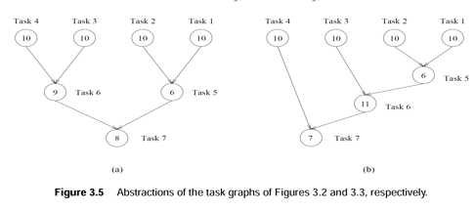
Exercise – Task Dependence Graph
Maximum Degree of concurrency: ?
Critical path lengths: ?
Total amount of work: ?
Average degree of concurrency: ?

Slide 24
Task Interaction Graph
Depicts pattern of interaction between the tasks
Dependency graphs show that how output of first task becomes input to the next level task
But how the tasks interact with each other to access distributed data is depicted by task interaction graphs
The nodes in a task-interaction graph represent tasks
The edges connect tasks that interact with each other
Example: Dense matrix-vector multiplication

Slide 25
Task Interaction Graph (Cont.)
The edges in a task interaction graph are usually undirected
But directed edges can be used to indicate the direction of flow of data, if it is unidirectional
The edge-set of a task-interaction graph is usually a superset of the edge-set of the task-dependency graph
Tasks 1, 2, 3, 4, 5, and 6 interact each other
Tasks 4 is dependent on the result of task 2
In database query processing example, the task-interaction graph is the same as the task-dependency graph.

Slide 26
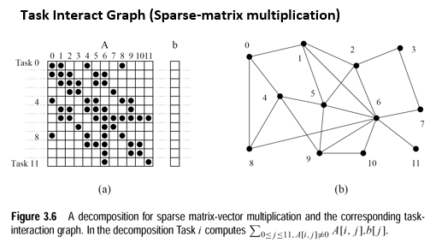
Task Interaction Graph (Cont.)

Slide 27
Processes and Mapping
Logical processing or computing agent that performs tasks is called process
The mechanism by which tasks are assigned to processers for execution is called mapping
Multiple tasks can be mapped on a single processor
Independent task should be mapped onto different processors
Map tasks with high mutual-interactions onto a single processor
A parallel program must have several processors active and simultaneously working on different tasks to gain a significant speedup over the sequential program

Slide 28
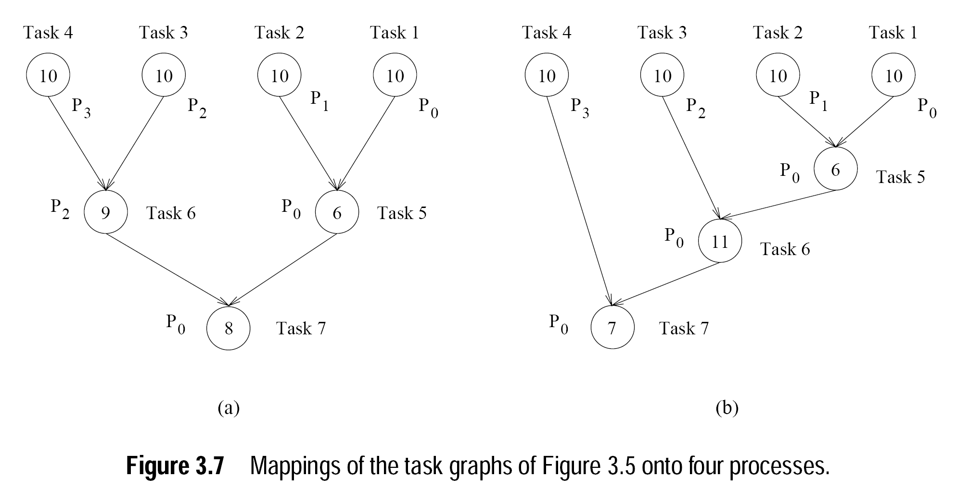
Processes and Mapping (Cont.)

Slide 29
Processes vs Processors
Processes are logical computing agents that perform tasks
Processors are the hardware units that physically perform computations
Depending on the problem, multiple processes can be mapped on a single processor
But, in most of the cases, there is one-to-one correspondence between processors and processes

Slide 30
Summary
Steps in Parallel Algorithm Design
Identification - Identification of parallel portion in the program
Mapping - Mapping concurrent tasks onto multiple processers
Data Partitioning - Distribution of input, output, and intermediate data associated with the program
Defining Access Protocol - Managing accesses to data shared by multiple processors
Parallel Computing Example
IBM Deep Blue machine beats Chess World Champion Kasparov using 30 nodes of 120 MHZ microprocessors
Task Decomposition
Dividing of a process into multiple tasks that may be arbitrary sizes

Slide 31
Summary (Cont.)
Multiplication of a Dense Matrix with a Vector
Vector Multiplication n x 1
Matrix Multiplication n x n
Independent computation, no task dependency graph
Task Dependency Graph
An abstraction used to express dependencies among tasks and their relative order of execution
A directed acyclic graph in which node are tasks and the directed edges indicate the dependencies between them
Example of Task Dependence
Execution of a database query

Slide 32
Summary (Cont.)
Granularity
Number and sizes of tasks into which a problem is decomposed determines the granularity of the decomposition
A decomposition into a large number of small tasks is called fine-grained
A decomposition into a small number of large tasks is called coarse-grained
Maximum and Average Degree of Concurrency
Maximum number of tasks that can be executed simultaneously in a parallel program at any given time is known as its maximum degree of concurrency
Average number of tasks that can run concurrently over the entire duration of execution of the program

Slide 33
Summary (Cont.)
Critical Path and Critical Path Length
Critical Path: The longest directed path between any pair of start and finish nodes.
Critical Path Length: The sum of the weights of nodes along the critical path
Task Interaction Graph
Dependency graphs show that how output of first task becomes input to the next level task
But how the tasks interact with each other to access distributed data is depicted by task interaction graphs

Slide 34
Summary (Cont.)
Processes and Mapping
Logical processing or computing agent that performs tasks is called process
The mechanism by which tasks are assigned to processers for execution is called mapping
Processes vs Processors
Processes are logical computing agents that perform tasks
Processors are the hardware units that physically perform computations
Summary
Additional Resources

Slide 35
Additional Resources
Book: Introduction to Parallel Computing by Ananth Grama and Anshul Gupta
Chapter 3. Principles of Parallel Algorithm Design
Section 3.1: Preliminaries

Slide 36
Questions?

